Slide 1

TRUBA INSTITUTE OF ENGEENERING AND INFORMATION TECHNOLOGY
PROJECT
ZILA VIKAS MANCH
UNDER GUIDANCE OF :
AMIT SAXENA (HOD of CS,IT)
PUNEET HIMTHANI
KAPIL RAGHUWANSHI
SUBMITTED BY :
SIKANDER MAKRANI
MOHD. ALAM KHAN
AKANKSHA SINHA

Slide 2
INTRODUCTION
The main purpose of this project is to provide bridge between Collector and students and their ideas.
Students can give their innovative ideas in the form of solutions and those solutions will be uploaded by Institute Representative after verification.
Students can participate in solving Government Problems.
Student will be awarded if the authority likes the solution of that student .

Slide 3
OBJECTIVE
Zila Vikas Manch is an online portal , where collector or government authority posts their problems which are visible to IR(Institute Representative) of each institute .Institute representatives sends the problems to their respective groups of students. Students select the problems of their interest and submit the solution to the IR, which is then forward to government authority.

Slide 4
Specific Requirements
User Interface :
Software provides good graphical interface for the user , any user can operate on the system ,performing the requirement task such uploading the problems , selecting the problems and submitting the solution.
ll. Hardware Interface :
Operating System : Windows 10
Hard disk : 40GB
RAM : 256 MB
Processor : Intel Core i3
Software Interface :
Java Language
Net Beans IDE 7.0.1
MySQL Server

Slide 5
Technologies Used
Net Beans IDE
MySQL
Servlets
CSS
Js
HTML

Slide 6
User Characteristics
We have two levels of users
User module :
It is also divided in three levels
Collector Assistant:
He/She will upload the problems and selects the best solution uploaded by the Institute Representative .
Institute Representative :
He/She forwards the problems to the students and verify the solutions submitted by the students before forwarding to Collector.
Student :
He/She will select the problem of his/her interest and submit the solution to IR.
Administrator module :
Admin : He will have the full control on the project and will keep records of different permissions given to Collector ,IR and Students.

Slide 7
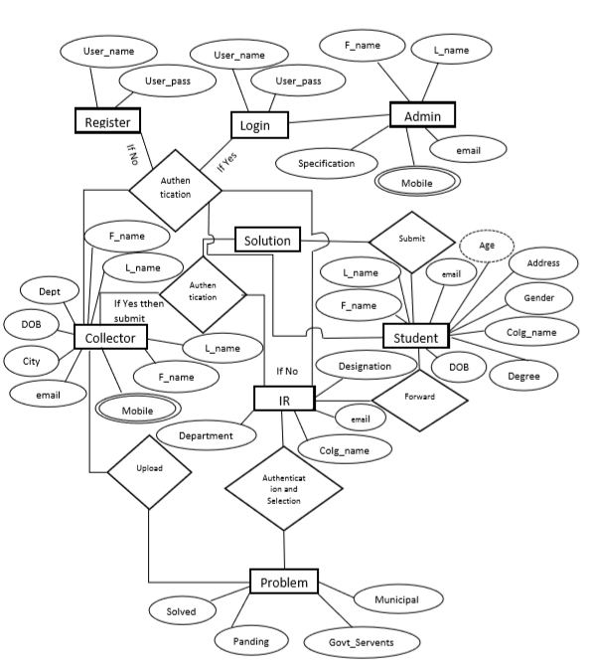
ER Diagram of Zila Vikas Manch
Entity :
An Entity in ER Diagram is a real time instance value of a table.
It is represented by a rectangle in ER Diagram.
Multivalued Attribute:
It contains more than one value for its entity.
It is denoted by double ellipse .
In the given diagram Mobile is the multivalued attribute.
Attributes:
Attributes are property of entity in ER Diagram.
It is represented by an ellipse.
What is ER Diagram?
An Entity Relationship(ER) Diagram is a type of flowchart that illustrates how entities interact with each other within a system.
Relationship :
It used for connection of two entities in ER Diagram.
Dashed ellipse or Derived Attribute:
Derived Attribute is an attribute which is calculated with the help of another attribute in the entity.
In the given diagram age is derived attribute because it is calculated with the help of Date of Birth.
Relationships in the given diagram are as follows:
Authentication
Submit
Forward
Upload
Entities in the given diagram are as follows:
Admin Collector
IR Student
Problem Solution
Register Login

Slide 8
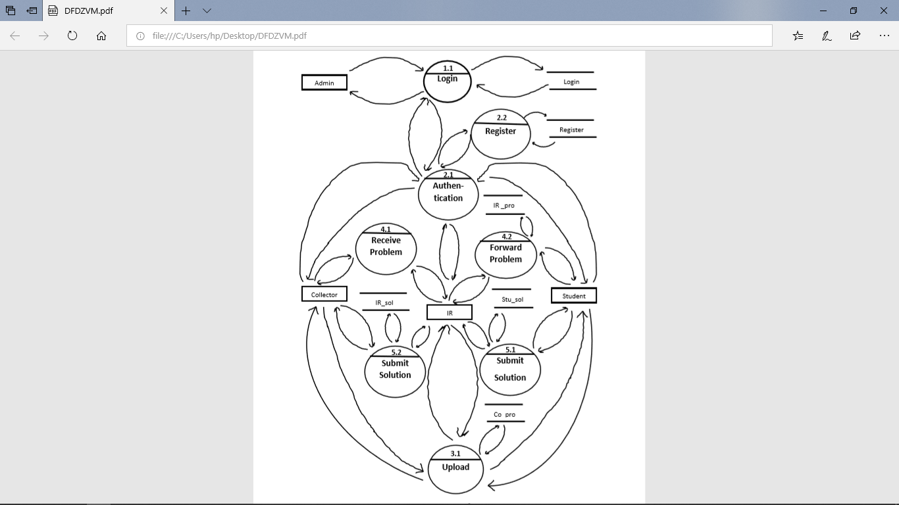
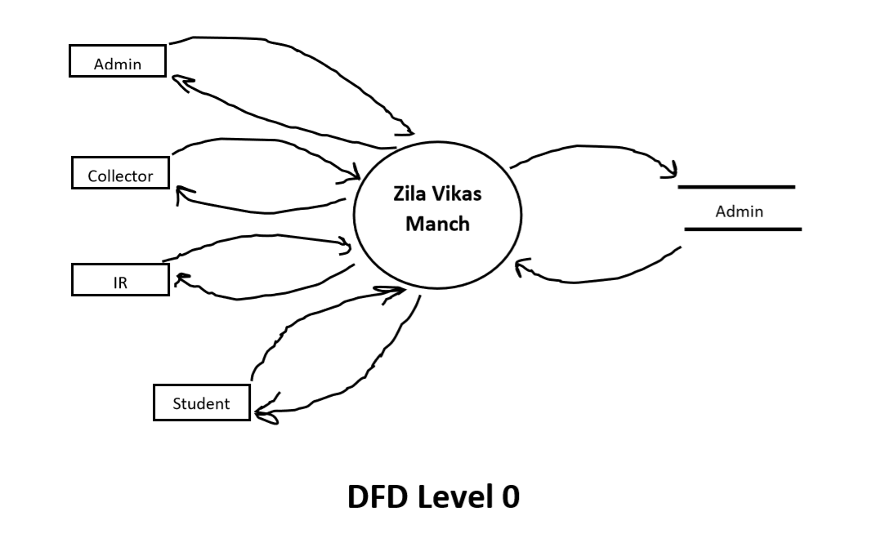
DFD Diagram of Zila Vikas Manch
Data Flow Diagram:
DFD is a visual representation of any process or system’s flow.
Following are the entities:
Admin Collector
IR Student
Data Flow Diagram Symbols:
External Entity represented by a rectangle.
Process:Process is a procedure that manipulates the data and its flow by taking incoming data ,changing it and producing an output with it.
3. Data Store: It hold information that is waiting to be processed.
Following are the Processes:
Register Login
Authentication Forward
Submit Upload
Following are the Data Stores:
stu_sol ir_sol
Ir_pro col_pro
Login register
DFD Level 1

Slide 9
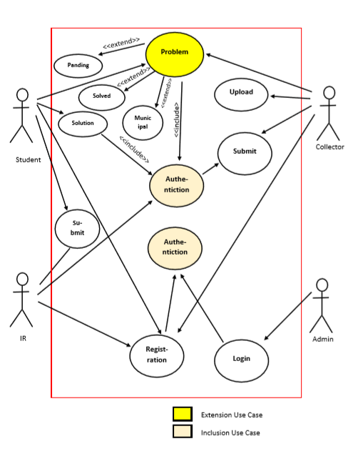
Use Case Diagram of Zila Vikas Manch
What is inclusion Use Case?
Use Case on which one or more other Use Case depends for their functionality is called inclusion use case.
What is use case Diagram ?
Use Case Diagram is a way of representing System Functionality .
What is an Actor?
Actor is someone or something interacting with use case.
Use Cases in this diagram are as follows :
Register
Login
Authentication
Upload
Problem
Solution
Actors in this diagram are as follows :
Admin
Collector
Institute Representative
Student
Each Actor must be linked to a use case, while some use cases may not be linked to actors.
In this diagra Authentication Use Case is Inclusion use case
Because before selecting problems uploaded by collector and before submitting solution to collector IR Authentication is necessary.

Slide 10
Water Fall Model
Key Features :
It is basic fundamental model of SDLC.
It is also known as linear sequential model.
It consist of five stages.
Advantages :
It is simple and easy.
It is mostly used for developing small projects and softwares.
Requirement Gathering and Analysis
Designing
Coding
Disadvantages :
No further updation.
Interaction with customer is done in first phase only.
Testing
Maintenance

Slide 11
FEATURES
By using this portal , students can solve the problems faced by district Collector .
This site is developed for addressing day to day problems of the society.
Institute Representative acts as a mediator between Collector or Authority and students.

Slide 12
Thank You

